Slide 2
About the Coalition for Urban Transitions
The Coalition is the leading global initiative supporting the efforts of national governments to transform cities in ways that accelerate economic development and encourage climate action
The Coalition equips national governments with the evidence-based research and policy tools necessary to make cities zero-carbon, resilient and inclusive
Shutterstock

Slide 3
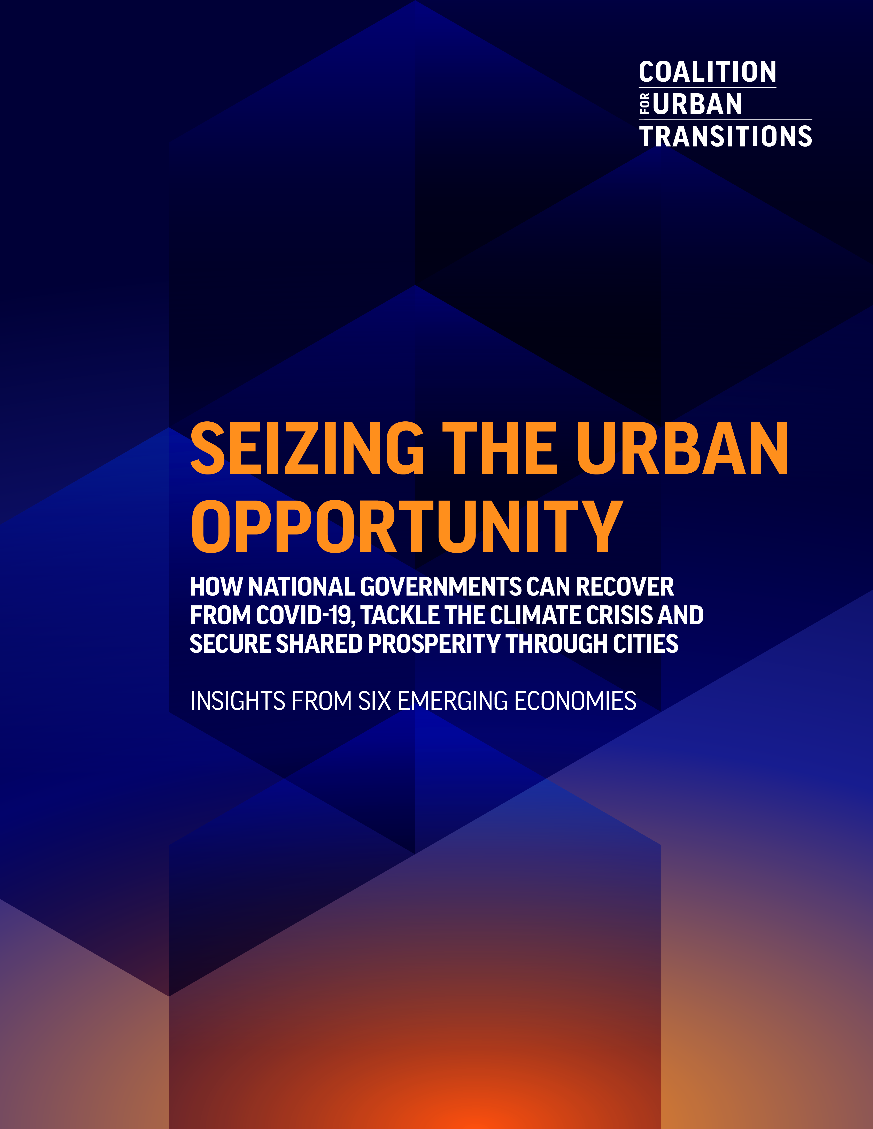
About the Seizing the Urban Opportunity report
Launched to support the COP26 UK Presidency in building momentum for enhanced climate ambition by national governments and other actors ahead of COP26 in Glasgow
The report is a collaborative effort, created in consultation with experts and policymakers in the six focus countries, with additional input from more than 36 organisations across five continents, following from the foundational 2019 Climate Emergency, Urban Opportunity report.

Slide 4
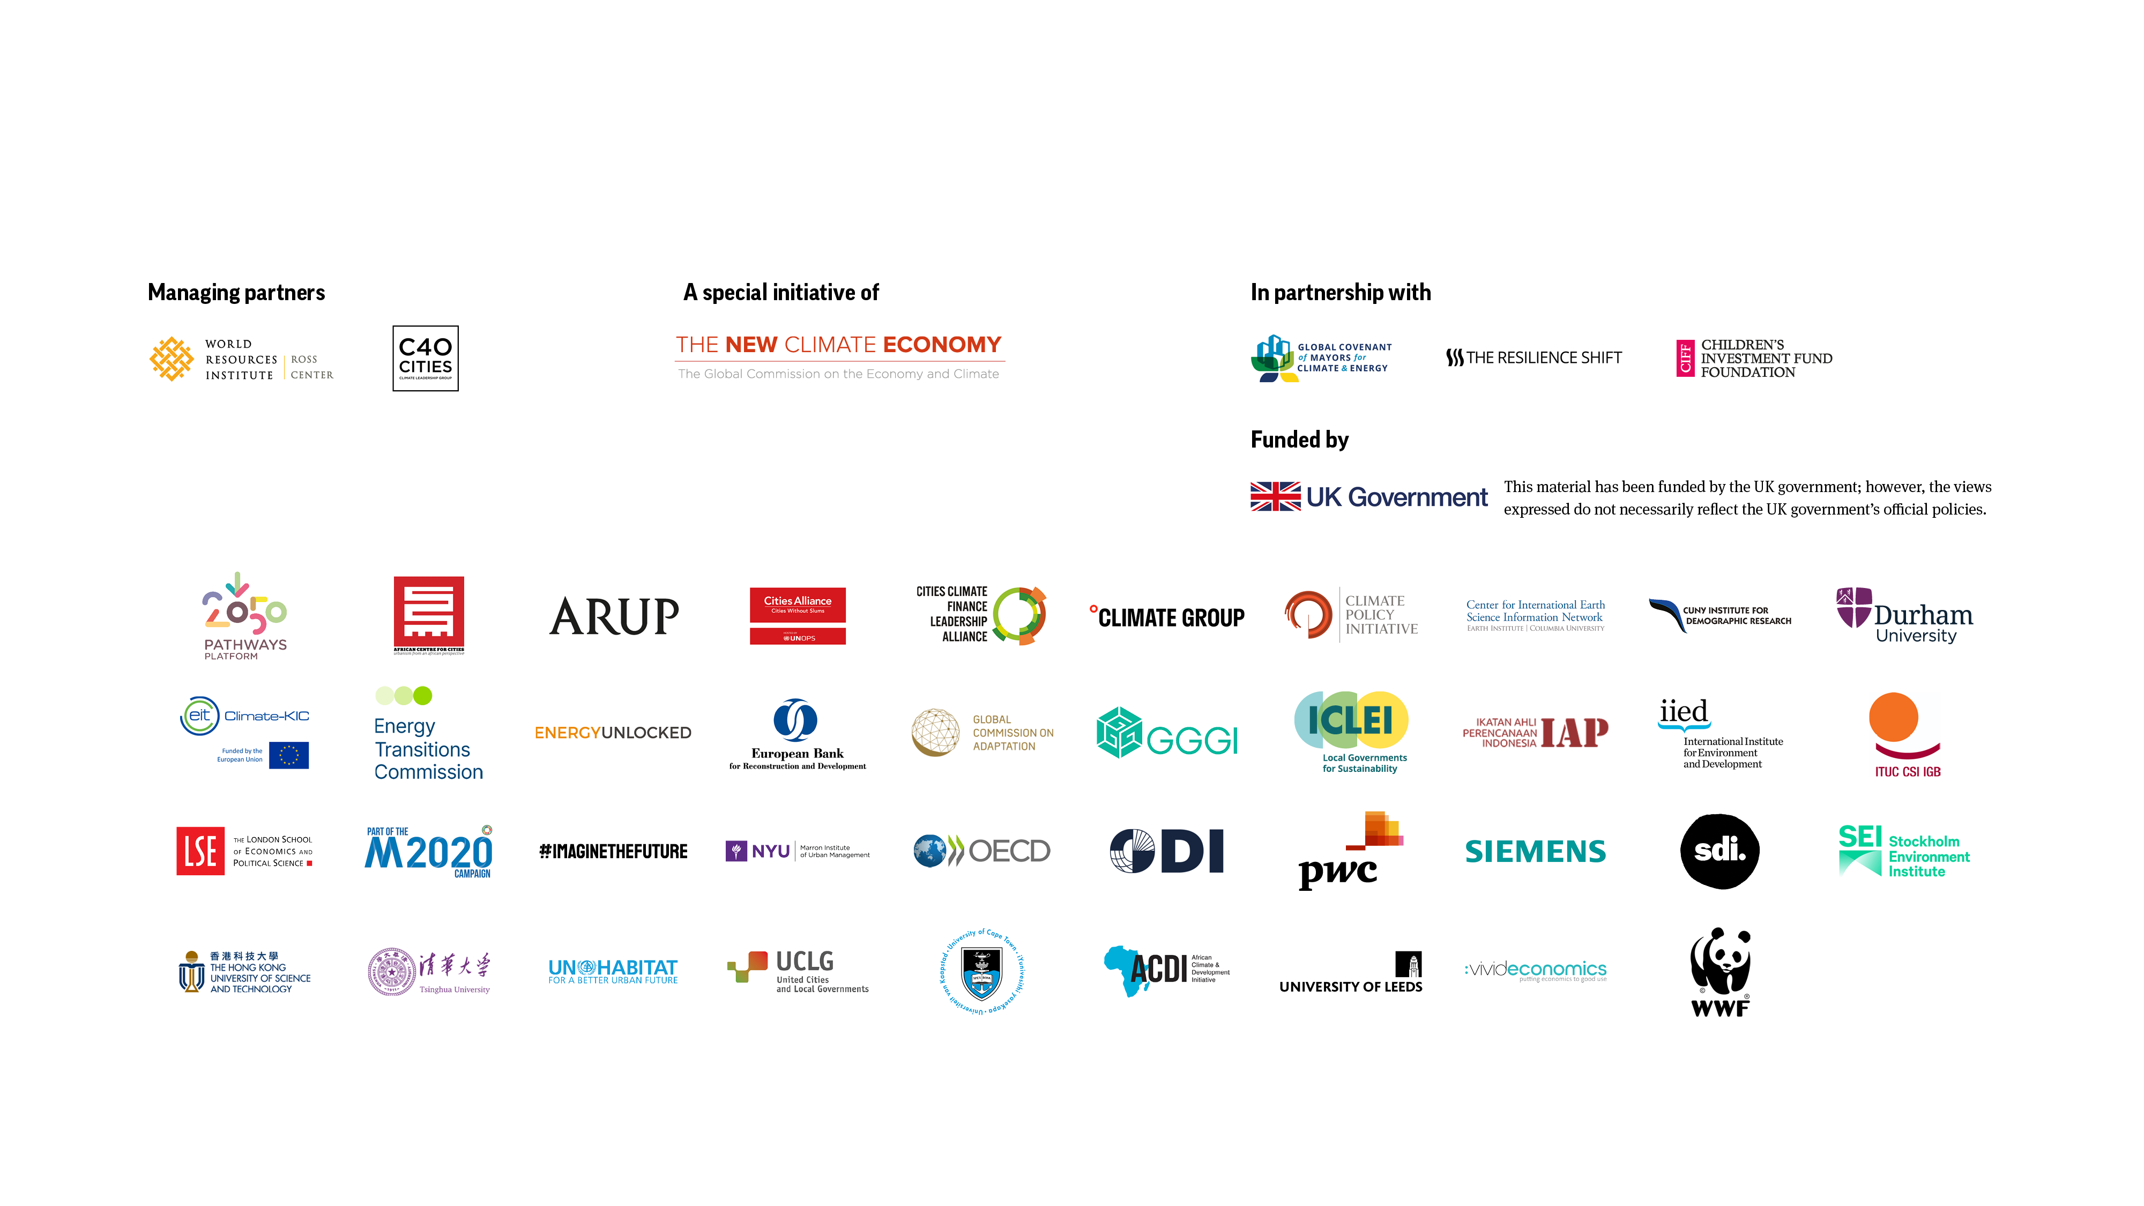
PARTNERS

Slide 5
The triple challenge facing national governments and the critical role of cities

Slide 6
Cities will be critical to solving the triple challenge of recovery, development & climate change
Cities are:
Economic engines, producing 80% of global GDP
Development and opportunity hubs, with efficiencies of scale, access to diverse job opportunities, vibrant communities, and cultural amenities
Significant emitters, responsible for 70% of energy-related global CO2 emissions
Notes:
Cities are central to countries’ vitality and need national leadership and support to realise their potential

Slide 7
The Time To Act is Now
This is a decisive decade – by 2030:
Trillions of dollars will be invested into long-lived urban infrastructure, which must be directed towards zero-carbon and resilient development
Nearly a billion people will be added to the global urban population, requiring compact, connected, clean and resilient places to live
Nearly half of CO₂ emissions must be reduced, with cities potentially delivering 58% of the energy-related emission reductions needed to keep the global temperature increase below 2°C

Slide 8
The Urban Opportunity KEY FINDINGS From our foundational 2019 report Climate Emergency, Urban Opportunity

Slide 9
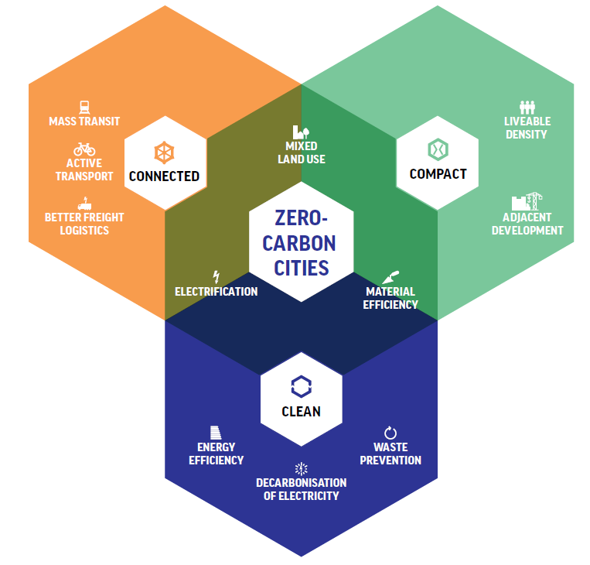
The Solution: Zero-carbon, resilient, and inclusive cities
National governments can create shared prosperity by making cities low-carbon, resilient and inclusive. This can be done by:
Adopting technically feasible, currently available low-carbon measures to create compact, connected, and clean cities by major investments to transform buildings, transport, materials use, waste, and land-use.
Enabling climate-resilient infrastructure and urban development, including through measures which tackle the socio-economic drivers of climate vulnerability and investments that can reduce emissions and enhance resilience at the same time.
Introducing measures to support marginalised communities, making cities even stronger and more inclusive, with particular benefits for the most vulnerable populations
Source: Coalition for Urban Transitions, 2019
Notes:
Graphic from Climate Emergency, Urban Opportunity 2019 report

Slide 10
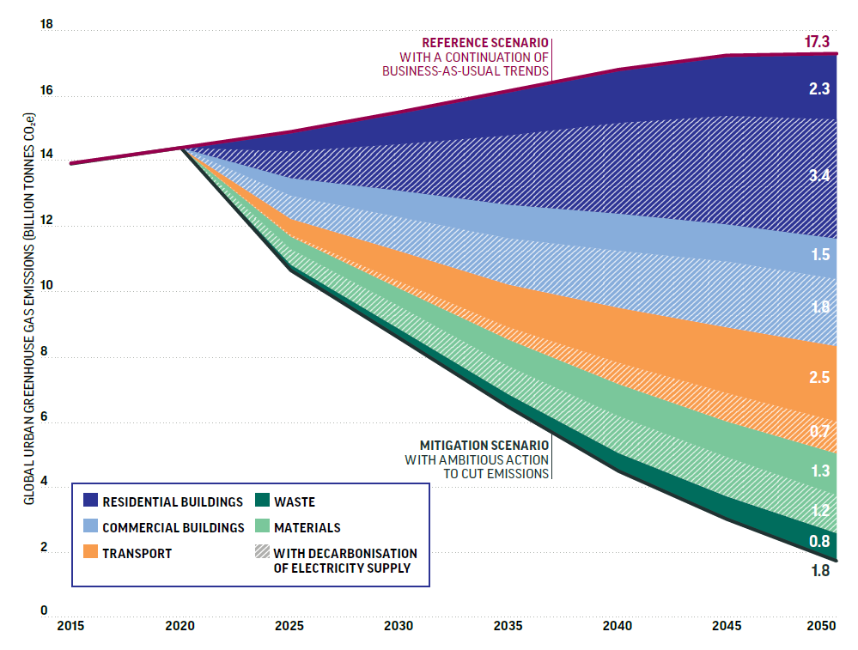
Globally, we know the pathway to zero-carbon cities and investments in cities offer some of the highest potential to unleash economic activity
A net zero urban transformation would:
Require new investment of ~2% of global GDP per year
Yield annual returns of US$2.8 trillion per year by 2030, and US$6.9 trillion per year by 2050, from energy and material cost savings alone ($24 trillion NPV)
Support 87 million jobs in 2030, and 45 million jobs in 2050
TECHNICALLY FEASIBLE POTENTIAL TO REDUCE GREENHOUSE GAS EMISSIONS FROM CITIES BY 2050, BY SECTOR
Source: Stockholm Environmental Institute and Vivid Economics for the Coalition for Urban Transitions, 2019

Slide 11
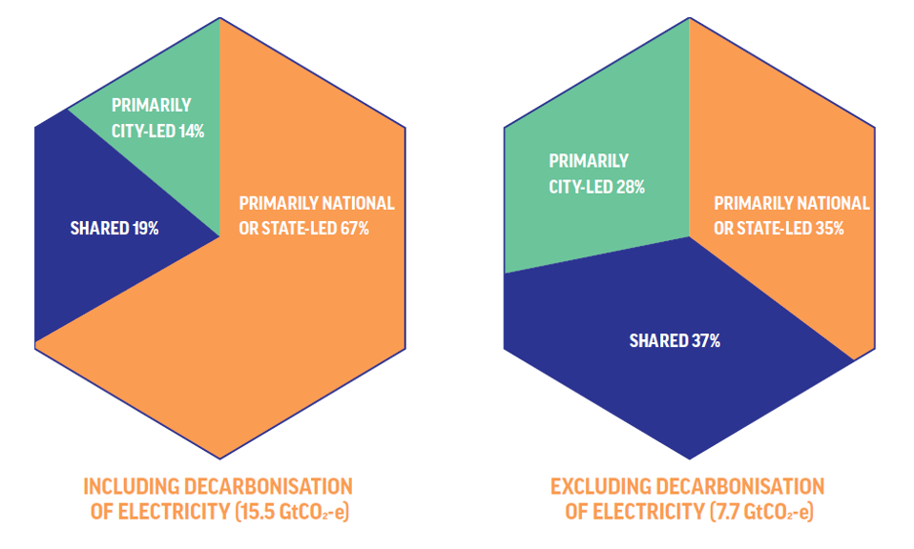
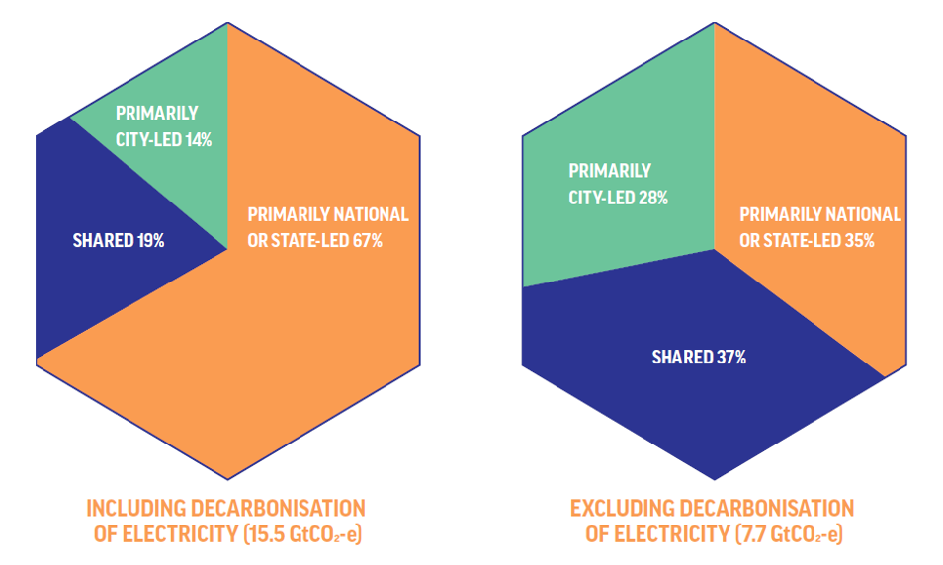
Local governments cannot drive the zero-carbon urban transition alone
National leadership to seize the urban opportunity will be critical
National or other higher-tier governments have primary authority over the measures required to achieve two-thirds of global urban abatement potential, including decarbonisation of electricity. In China and India, for example, the share is significantly higher.

Slide 12
Seizing the urban opportunity in six countries KEY FINDINGS
From the Seizing the Urban Opportunity report

Slide 13
Report Goals
The report evaluates how national governments can spur COVID-19 recovery, achieve shared prosperity and drive climate action through national policies and targeted investments to decarbonise cities and make them more resilient
This report shows the power of urban transformation and the many ways to achieve it by looking up close at six major emerging economies: China, India, Indonesia, Brazil, Mexico and South Africa

Slide 15
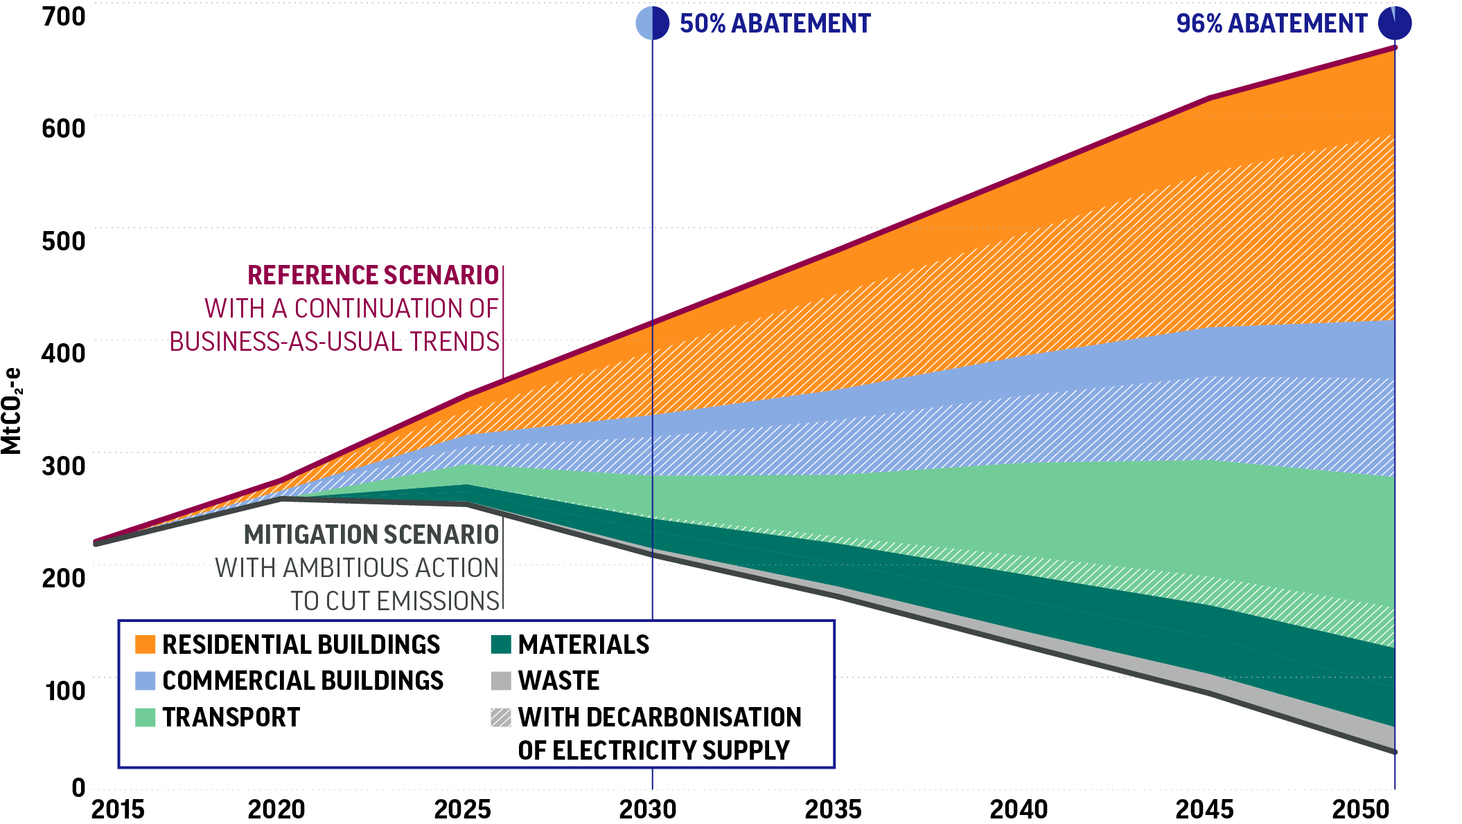
The pathway to zero-carbon cities is possible
GHG ABATEMENT POTENTIAL IN KEY URBAN SECTORS IN INDONESIA TO 2050
New analysis by the Stockholm Institute of Environment found that across these six countries, implementation of technically feasible solutions could collectively support significant economic and development benefits, and cut annual emissions from key urban sectors by 87-96% by 2050 beyond their initial NDC commitments under the Paris Agreement.
Source: Modelling by the Stockholm Environment Institute for the Coalition.

Slide 16
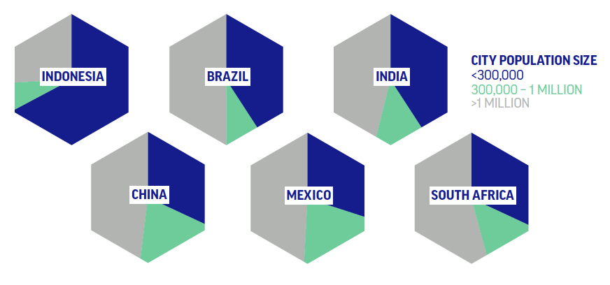
A significant amount of urban mitigation potential is in small and medium sized cities
Half of the possible urban emissions reduction lies in small and mid-sized cities, which often lack the financial and technical resources of larger cities and thus particularly need national government support.
In Indonesia, cities with fewer than 300,000 residents hold 68% of the cumulative potential. In Brazil and India, it’s 42%.
PROPORTION OF MITIGATION POTENTIAL IN CITIES IN 2050, BY COUNTRY
Source: Stockholm Environment Institute for the Coalition of Urban Transitions.

Slide 17
The investments required will yield benefits that exceed their costs by over US$12 trillion by mid-century
Country | Cumulative Incremental Investment to 2050 | Net Present Value of Investments to 2050
China | $5.5 Trillion | $7.7 Trillion
India | $3.6 Trillion | $1.6 Trillion
Indonesia | $1.0 Trillion | $2.7 Trillion
Brazil | $1.7 Trillion | $370 Billion
Mexico | $960 Billion | $210 Billion
South Africa | $270 Billion | $220 Billion
Source: Vivid Economics for the Coalition of Urban Transitions.
Notes:
These estimates of annual returns and net present value are sensitive to discount rates, energy prices, learning rates and other factors. This analysis considered the economic case under several scenarios: real discount rates of 1.4%, 3.5% and 5.5% per year, and real energy price increases of 1%, 2.5% and 4%. Learning rates are sector- and technology-specific. The data presented in this report reflect a 3.5% discount rate and a 1% real energy price increase.

Slide 18
Employment Benefits
Across the six countries, these investments could potentially support millions of new jobs in 2030, which includes:
China
India
Indonesia
Brazil
Mexico
South Africa
Source: Vivid Economics for Coalition for Urban Transitions

Slide 19
The costs of inaction are staggering
Floods caused an estimated
US$79.5 billion
in damages across India between 1998 and 2017
Many urban areas are plagued by increasing heat waves, extreme flooding, sea level rise, and more frequent natural disasters.
Vulnerable communities will be hit the hardest, making social resilience crucial to moving forward.
In China, sea-level rise and storm surges could cut the GDP of coastal regions by 11% by 2050 – in some cities by as much as 20%.
$

Slide 20
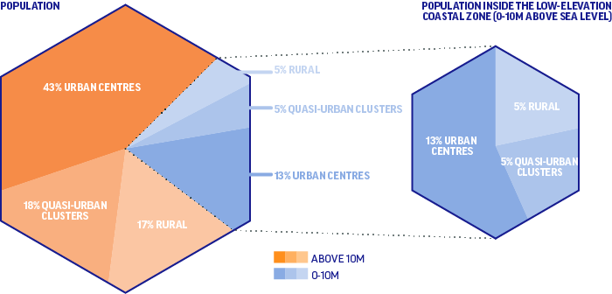
Sea level rise is an urban threat
SHARE OF INDONESIA’S POPULATION INSIDE AND OUTSIDE THE LOW-ELEVATION COASTAL ZONE BY SETTLEMENT TYPE, 2015
Over 10% of the world’s population - 820 million people - live less than 10 metres above sea level
86% of these people – over 700 million - live in urban centres or quasi-urban clusters
Populations in cities less than 10 metres above sea level are growing most rapidly
Source: CUNY Institute for Demographic Research, Institute for Development Studies and Center for International Earth Science Information Network, Columbia University.
Notes:
New analysis for this report by CUNY Institute for Demographic Research, the Institute of Development Studies and the Center for International Earth Science Information Network (CIESIN) at Columbia University found that 12% of the world’s population – over 700 million people – lived within 10 metres above sea level in 2015, and nearly 90% of those people lived in urban centres or quasi-urban clusters (which have lower densities than urban centres, and could include peri-urban or suburban areas). Three quarters of this vulnerable urban population live in Asia.
Over 11% of the land in this low-lying coastal zone is already urban or quasi-urban, compared with less than 2% elsewhere (see Figure 6), which contributes to the fact that coastal population densities are six times higher than the rest of the world (318 versus 54 people per square kilometre). This means that storm surges and sea-level rise are now overwhelmingly urban threats.
Moreover, population growth rates since 1990 have been higher in these low-lying coastal zones, and the growth rates in urban centres are about 20% higher in these areas than elsewhere. Growth rates in urban centres are actually highest in the lowest-lying areas – at less than 5 metres above sea level. Most of these settlements have developed with little regard for coastal environmental sensitivities, and almost no regard for growing climate risks.

Slide 21
Coastal development is coming at an enormous cost
Large projects continue to be built in low-lying coastal areas.
In 2017, Semarang announced a major expansion of the Tanjung Emas Port, reclaiming more than 100 hectares of coastal land for development.
Governments risk spending public funds on assets that may become stranded due to sea level rise, frequent floods, major changes in precipitation, or other climate hazards.
Source: Google Earth, Image© 2021 Maxar Technologies. Image © 2021 TerraMetrics. Data SIO, NOAA, U.S. Navy, NGA, GEBCO

Slide 22
Many investments can enhance resilience and reduce emissions at the same time: Nature-based solutions will be key to protecting vulnerable communities while reducing GHG emissions
Restoring and protecting mangroves near coastal cities would reduce those cities’ vulnerability to storms by providing natural buffers – and boost carbon storage, as mangroves are powerful carbon sinks.
Restoring and protecting coastal peatlands would not only reduce land subsidence and flood risks, but also avoid large amounts of GHG emissions and air pollution from fires.
Aerial view of Shenzhen, China. Source: Shutterstock

Slide 23
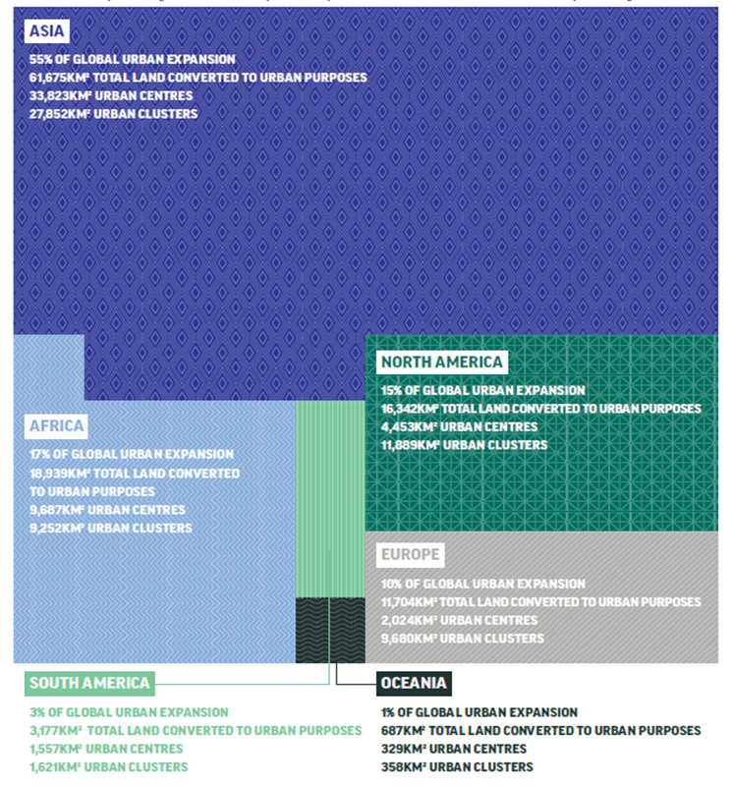
Compact urban growth enhances resilience and food security, whilst reducing carbon footprints
112,524km² of land was converted to urban areas between 2000 and 2014 - twice the size of Sri Lanka
Over half was cultivated land
Over half was in Asia
Source: Marron Institute of Urban Management, New York University, for the Coalition for Urban Transitions and the Food and Land Use Coalition, 2019
Notes:
A new analysis by New York University for this report found that urban settlements grew by about 112,524 square kilometres between 2000 and 2014, twice the area of Sri Lanka.
Two thirds of this urban expansion occurred in Asia, and one fifth in Africa.
China alone accounted for 38.9% of the new urban extent, while a further 10.7% was in India. Thereafter, Nigeria, Mexico and Vietnam saw the most urban expansion, accounting for 4.9%, 2.0% and 1.2% of new urban land, respectively.

Slide 24
Country Snapshots

Slide 25
Country Snapshots - China
Cities are home to three-fifths of the population and produce 90% of GDP.
However, they struggle with congestion, air pollution and sprawl, with some cities already experiencing severe climate change impacts.
China is actively taking steps to build resilience through programmes such as “Sponge Cities”.
Low-carbon measures in cities could support the equivalent of:
Would require cumulative investments of US$5.5 trillion to 2050 and yield returns with a net present value of US$7.7 based on cost savings alone.
 | New Jobs | Reduction in GHG Emissions
2030 | 15.2m | 48% (1,926 Mt CO2-e)
2050 | 3.5m | 89% (3,372 Mt CO2-e)
Notes:
Update graphic

Slide 26
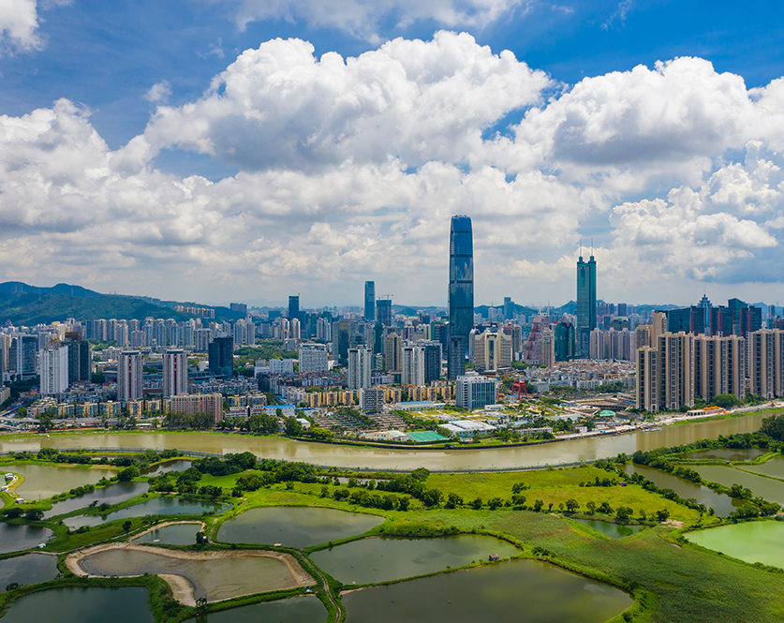
Country Snapshots - China
Recommendations
Putting sustainable cities at the heart of the implementation of the14th Five-Year Plan annual investment plan and China’s updated Nationally Determined Contributions (NDCs)
Prioritising energy-efficient buildings
Supporting small and mid-sized cities to become more sustainable and resilient
Incorporating climate objectives in national urban design and regeneration strategies
Notes:
Shenzhen, China. Source: Shutterstock

Slide 27
Country Snapshots- India
India’s cities are already economic powerhouses, contributing 63% of GDP in 2011 and a projected 75% by 2030.
Many cities struggle to provide housing, services and jobs for all their residents, resulting in exacerbated climate threats.
Key national programmes, like the ClimateSmart Cities Assessment Framework, are actively working to make India’s cities more resilient, sustainable and inclusive.
Low-carbon measures in cities could support the equivalent of:
Would require cumulative investments of US$3.6 trillion to 2050 and yield returns with a net present value of US$1.6 trillion based on cost savings alone.
 | New Jobs | Reduction in GHG Emissions
2030 | 8.2m | 53% (640 Mt CO2-e)
2050 | 3.0m | 89% (1,784 Mt CO2-e)
Notes:
Update graphic

Slide 28
Country Snapshots- India
Recommendations
Aligning national infrastructure and urban development policies programmes and investments with the vision of ClimateSmart Cities
Stepping up investments in sustainable transport
Scaling up urban energy efficiency and clean energy initiatives.
Notes:
Jaipur, India. Source: Shutterstock

Slide 29
Country Snapshots - Indonesia
Indonesian cities are rapidly urbanising, with 55% of its population in cities in 2018, and a projected 75% by 2050.
Many cities lack basic services such as piped water, modern sanitation, and suffer from severe traffic congestion and air pollution.
Flood risks due to land subsidence are a major concern, and Indonesia is actively planning to restore 2 million hectares of peatland within five years to mitigate the climate risk.
Low-Carbon measures in cities could support the equivalent of:
Would require cumulative investments of US$1.0 trillion to 2050 and yield returns with a net present value of US$2.7 trillion based on cost savings alone.
 | New Jobs | Reduction in GHG Emissions
2030 | 2.3m | 50% (253 Mt CO₂-e)
2050 | 0.9m | 96% (790 Mt CO₂-e)

Slide 30
Country Snapshots - Indonesia
Recommendations
Investing in sustainable urban mobility
Scaling up ecosystems restoration in and around cities
Accelerating the transition to clean electricity
Leveraging the Smart Cities movement, which already includes 100 cities, to advance sustainability, resilience-building and inclusion.

Slide 31
Country Snapshots - Brazil
Cities are home to 87% of the population as of 2018 and generate at least 63% of GDP.
Population growth is greatest in small cities, with limited capacity for planning or service delivery, resulting in greater inequality.
Brazil has been a leader in urban innovation and will need to continue to prioritise low-carbon transport investments and participatory budgeting and planning.
Low-Carbon measures in cities could support the equivalent of:
Would require cumulative investments of US$1.7 trillion to 2050 and yield returns with a net present value of US$370 billion based on cost savings alone.
 | New Jobs | Reduction in GHG Emissions
2030 | 4.5m | 35% (75 Mt CO₂-e)
2050 | 1.3m | 88% (238 Mt CO₂-e)

Slide 32
Country Snapshots - Brazil
Recommendations
Supporting metropolitan governance to foster integrated and sustainable urban development
Prioritising low-carbon transport investments
Revamping national housing programmes and policies to ensure compact and connected development
Expanding finance for urban decarbonisation and resilience building projects.
Notes:
Salvador, Brazil. Source: Travelhock/Shutterstock

Slide 33
Country Snapshots - Mexico
Mexico is highly urbanised, with 80% of its population in cities and 90% of gross value produced in urban areas.
Many cities struggle with urban sprawl, traffic congestion and air pollution, exacerbating issues of climate change and inequality.
Important reforms are already underway, like the National Strategy of Territorial Planning 2020-2040 and the National Housing Programme, which work to make Mexico’s cities more resilient, sustainable and inclusive.
Low-Carbon measures in cities could support the equivalent of:
Would require cumulative investments of US$960 billion to 2050 and yield returns with a net present value of US$210 billion based on cost savings alone.
 | New Jobs | Reduction in GHG Emissions
2030 | 0.5m | 34% (98 Mt CO2-e)
2050 | 0.1m | 87% (284 Mt CO2-e)

Slide 34
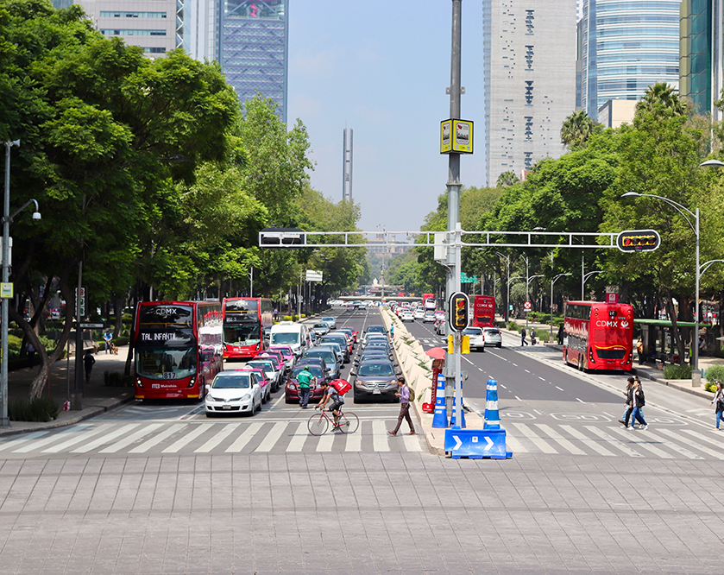
Country Snapshots - Mexico
Recommendations
Supporting the creation of metropolitan authorities for integrated land use and transport planning
Expanding the supply of affordable and well-situated housing connected to public transport
Prioritising a just transition to zero-carbon cities, with special attention to poor and marginalised people
Notes:
Mexico. Source: Albert John

Slide 35
Country Snapshots – South Africa
South Africa’s cities are powerful economic engines, home to 66% of the population.
However, many cities lack basic services such as piped water, modern sanitation and electrification, and public transport, and there is a growing concern over water scarcity.
Fortunately, cities already play a prominent part in national policies like the Long-Term Low Emissions Development Strategy (SA-LEDS), a policy aiming to reach net-zero GHGs by 2050.
Low-Carbon measures in cities could support the equivalent of:
Would require cumulative investments of US$270 billion to 2050 and yield returns with a net present value of US$220 billion based on cost savings alone.
 | New Jobs | Reduction in GHG Emissions
2030 | 0.7m | 54% (81 Mt CO₂-e)
2050 | 0.3m | 92% (146 Mt CO₂-e)

Slide 36
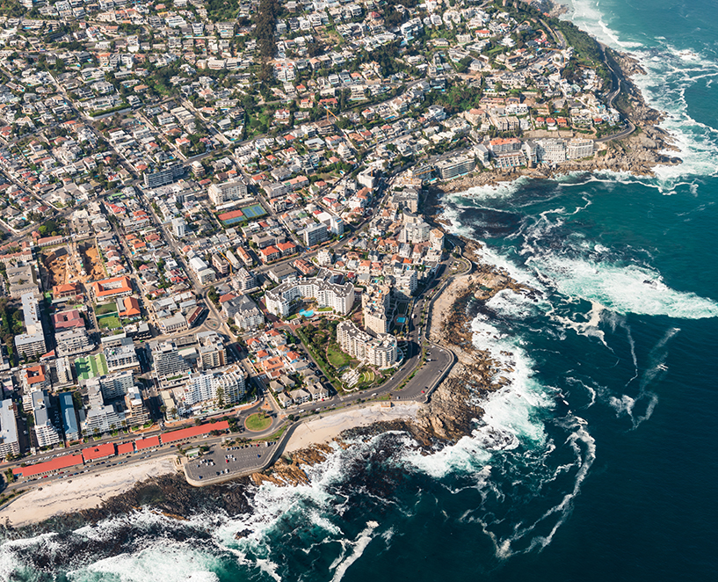
Country Snapshots – South Africa
Recommendations
Strengthening municipalities’ ability to purchase their own power
Putting pro-poor urban measures at the heart SA-LEDS implementation
Prioritising improved mobility for lower-income urban residents
Protecting and restoring ecosystems in and around cities
Notes:
Cape Town, South Africa. Source: Handmade Pictures

Slide 37
A Global Call to Action

Slide 38
Recommendations for national leaders
Develop an overarching strategy to deliver shared prosperity while reaching net-zero emissions – and place cities at its heart.
Pursue national policies to support cities that are compact, connected, clean and resilient.
Fund and finance urban infrastructure that is sustainable and resilient.
Support local climate action in cities through governance and fiscal reforms that empower local governments and facilitate collaboration.
Proactively plan for a just and resilient urban transition by prioritising measures that build resilience and expand economic opportunities for the urban poor.
Work in partnership with the private sector to help finance urban transformation.
India has pledged to mobilise up to $2 trillion in public and private finance through a National Infrastructure Pipeline that could be truly transformative.

Slide 39
Recommendations for urban leaders
Work together with national governments in their efforts to support cities that are compact, connected, clean, and resilient.
Keep innovating and raising local ambitions, such as pursuing pilot projects in major cities that can be emulated by communities nationwide.
Strengthen the role of communities in cities, especially poor and marginalised people, in planning and decision-making processes that affect their lives.
Raise awareness about the need to seize the urban opportunity.
China’s 14th Five-Year Plan and South Africa’s SA-LEDS offer opportunities to implement strategies to deliver shared prosperity while reaching net-zero emissions

Slide 40
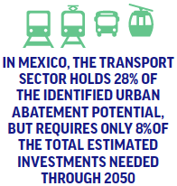
Recommendations for the development community
Build a multilateral system that fosters inclusive, resilient, zero-carbon cities, by making urban action a priority in climate and development finance, especially in countries that are urbanising rapidly and face significant challenges meeting city residents’ needs.
Work with national governments to redirect development assistance and concessional finance away from investments that exacerbate climate risks towards urban transformation.
Support low-carbon and resilience-building investments with longer payback times.

Slide 41
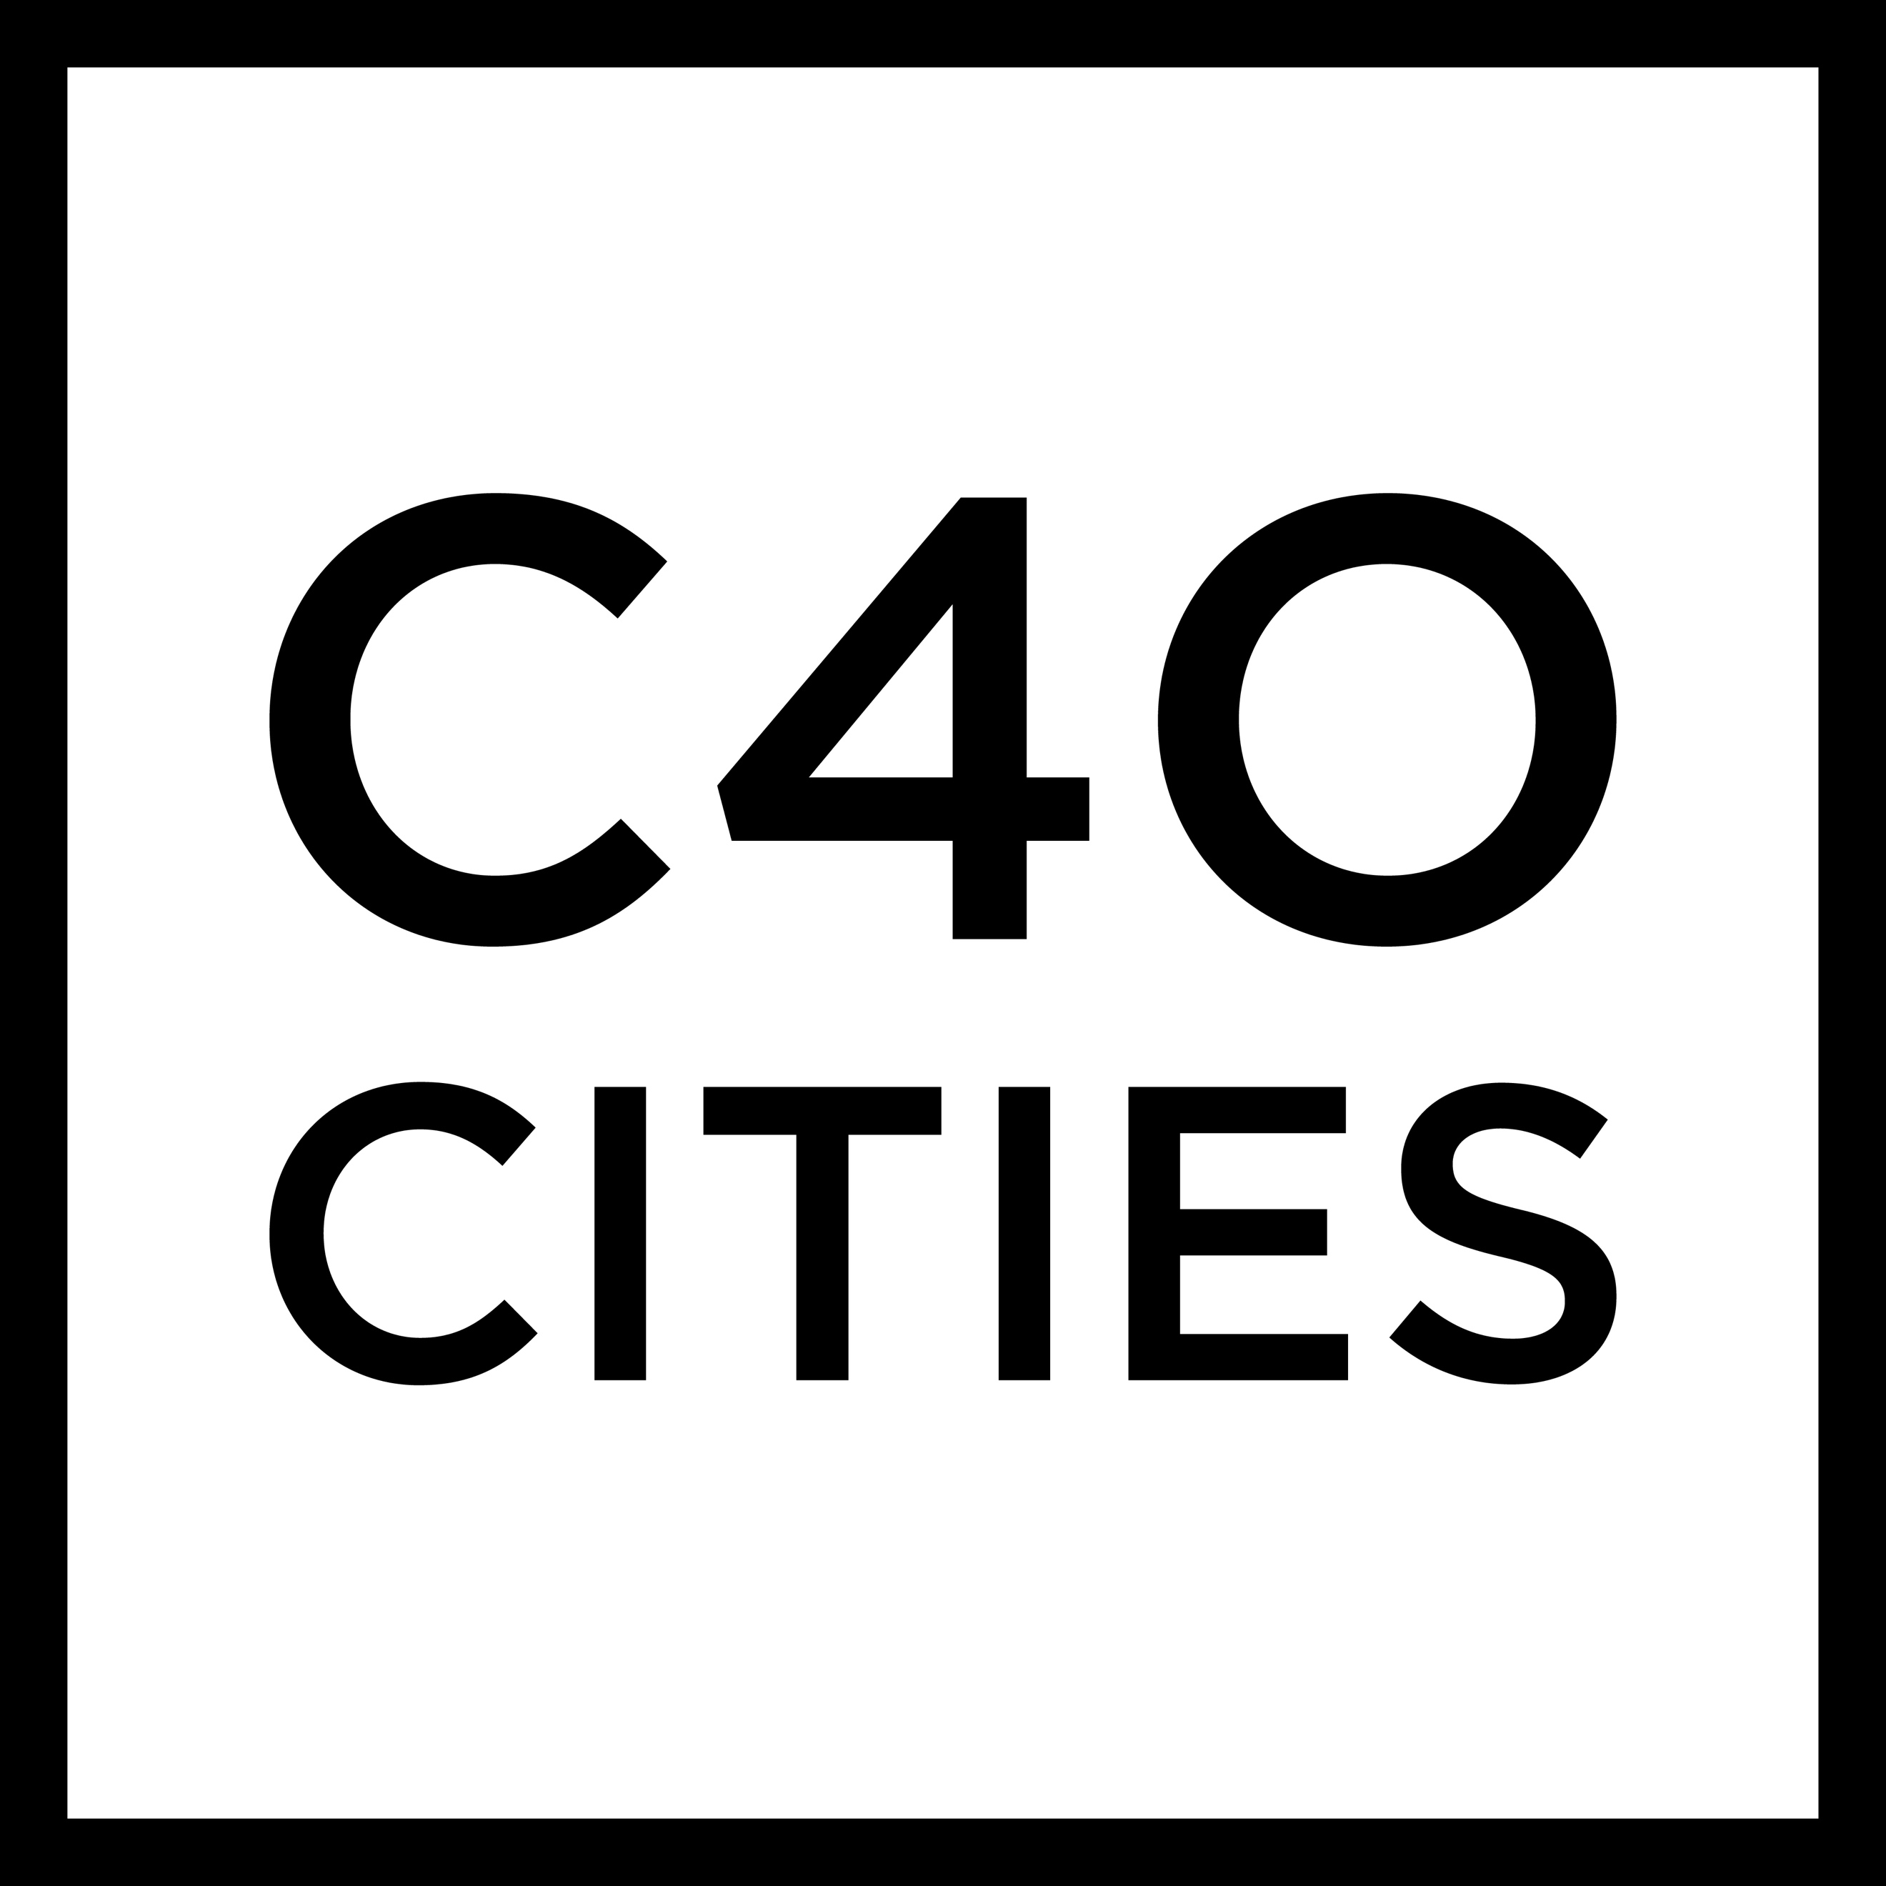
urbantransitions.global
#UrbanOpportunity
Co-managed by
Report funded by
In partnership with

