Slide 2
About the Coalition for Urban Transitions
The Coalition for Urban Transitions is the leading initiative helping national governments secure economic prosperity and tackle the climate crisis by transforming cities.
The Coalition equips national governments with the evidence and policy options to deliver more compact, connected, clean urban development
The Coalition’s country programmes in China, Ghana, Mexico and Tanzania provide models on how to effectively develop national urban policies and infrastructure investment strategies.

Slide 3
As cities go, so goes the planet
50% of the population – over 2/3 by 2050
80% of
global GDP
75% of energy-related emissions
Source: Coalition for Urban Transitions, 2019

Slide 4
The solution: zero-carbon cities
National governments that create compact, connected and clean cities will secure economic prosperity and better living standards
Countries that do not embrace the zero-carbon urban transition will be left behind
Source: Coalition for Urban Transitions, 2019
Notes:
National governments that prioritise zero-carbon cities today will secure economic prosperity and better living standards tomorrow.
By fostering compact, connected and clean cities, national governments can secure a national competitive advantage in the race for global investment, create long-term, inclusive, climate-compatible growth, and deliver better lives for citizens across the country.
People around the world could live in neighbourhoods where they can walk quickly and safely to work, school and parks, along quiet streets with plenty of places to meet and rest. Pedestrians and cyclists could enjoy protected sidewalks and paths lined with trees, shops and restaurants. Speed limits on the streets could be low enough that everyone feels safe crossing – even if they are elderly, disabled or pushing a pram. With steady foot traffic, local retailers and eateries would thrive. Well-maintained public transit could offer convenient and comfortable commutes, connecting every district so that people do not have to drive. The few vehicles on the streets could all be electric, quiet and pollution-free. With much cleaner air in cities, asthma, allergies and other respiratory diseases would be far less common. It would be more pleasant inside homes and commercial buildings, with increased natural lighting, good ventilation, and material and design choices that limit the need for temperature control. Combined with rooftop solar panels and highly efficient heating and cooling systems, compact, connected and clean cities would sharply reduce costs for households and businesses.
Countries that do not embrace this transition will be left behind.
High-carbon systems will become unprofitable or inoperable as markets and regulations evolve. The result will be stranded assets and stranded workers as industries fail or relocate.
Will dense cities actually be pleasant places to live?
Many of the world’s most liveable and attractive cities are very dense. With their terraced houses or townhouses, cities such as Amsterdam, Boston and Vienna have very high population densities - but these cities conserve enough green space and provide such good services that they do not feel overcrowded. With their medium- and high-rise housing, cities such as Tokyo, Seoul and Hong Kong have high population densities. But they are also among the most vibrant and liveable cities in Asia, with vibrant streetscapes, safe sidewalks and lots of parks and other public amenities.
Even within sprawling cities, it is the dense and walkable neighbourhoods that are often most in demand. It is homes in the inner city of London or Sydney that command the highest house prices, with people competing to live in smaller homes that offer the benefits of density: easy access to jobs and services, a diversity of local shops and restaurants, and green space that has been carefully preserved.
These neighbourhoods and cities have carefully managed density to maximise the benefits and minimise the costs. Careful planning and infrastructure investment is important to ensure that the poor are not pushed to the margins, to avoid pollution from cars or waste, and to create public green spaces that all urban dwellers can enjoy.

Slide 5
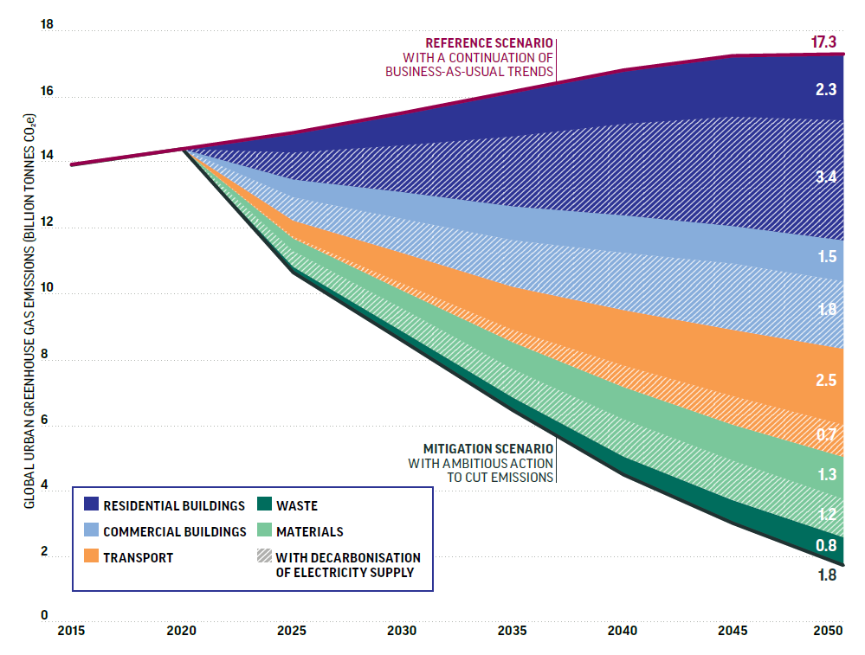
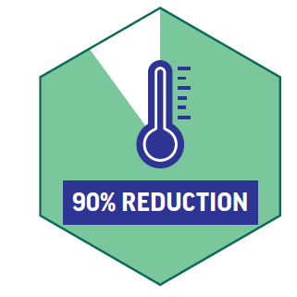
We know the pathway to zero-carbon cities
IN URBAN EMISSIONS BY 2050
Source: Stockholm Environmental Institute for the Coalition for Urban Transitions, 2019
Notes:
It is possible to cut 90% of emissions from cities (15.5 GtCO2e by 2050) using proven technologies and practices.
SHORT: Decarbonising electricity contributes a substantial share of the emissions reductions potential in every sector. Beyond that, buildings have the largest role (3.8 GtCO2e by 2050), followed by the transport sector (2.5 GtCO2e by 2050).
LONG: In absolute terms, these savings are greater than the combined 2014 energy-related emissions of the two largest emitters, China and the U.S. 58% of these carbon savings come from the buildings sector, 21% from the transport sector, 16% from materials efficiency and 5% from the waste sector
Overall, urban sectors can contribute 62% of global energy-related GHG reductions needed for a 2C pathway in 2030, and 58% of global energy-related GHG reductions needed for a 2C pathway in 2050.

Slide 6
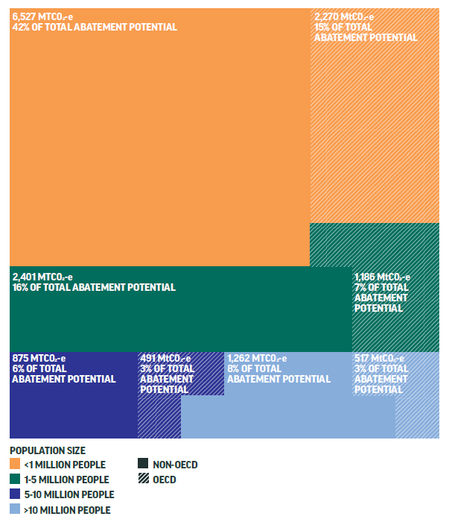
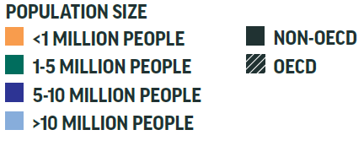
Over half of the urban abatement potential is in cities with fewer than 1 million residents
Source: Stockholm Environmental Institute for the Coalition for Urban Transitions, 2019
Notes:
Fully half of the possible urban emissions reduction must happen in cities with fewer than 750,000 people,
These small and medium size cities often lack the financial and technical resources of larger cities and therefore are in particular need of national government support.

Slide 7
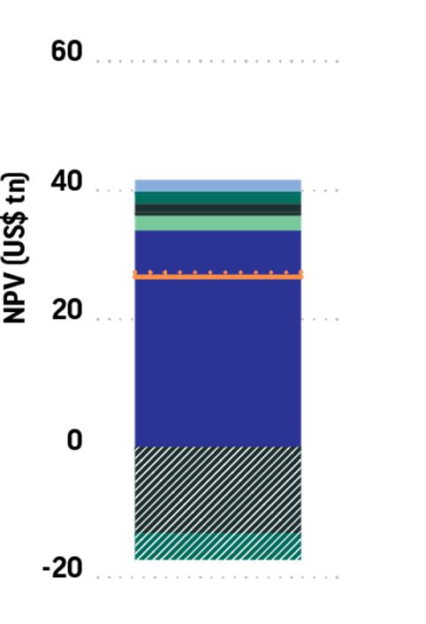
These investments will yield benefits that exceed their costs by almost US$24 trillion by mid-century
These investments would:
Require new investment of 2% of global GDP per year
Yield annual returns of US$2.8 trillion per year by 2030, and US$6.9 trillion per year by 2050, from energy and material cost savings alone
Support 87 million jobs in 2030, and 45 million jobs in 2050
NET PRESENT VALUE (US$ trillions)
Source: Vivid Economics for the Coalition for Urban Transitions, 2019
Notes:
The bundle of low-carbon investments in cities that would be needed to reduce emissions by 90% also offers attractive economic returns worth almost US$24 trillion by 2050.
INCREMENTAL: The investments required to reduce urban emissions would be US$1.8 trillion (about 2% of global GDP) per year, but they would generate annual savings worth US$2.8 trillion in 2030 and US$7 trillion in 2050. This yields a net present value of US$23.9 trillion.
CUMULATIVE: Investments of US$ 56.7 trillion (or US$1.83 trillion per year, equivalent to about 2% of global GDP) would yield returns of US$2.8 trillion per year by 2030, and US$6.98 trillion per year by 2050.
These measures could support 86.7 million jobs by 2030, and 45.4 million jobs by 2050.
7 out of 17 measures studied have an average payback period of one year or less.
The top three measures with the highest net present value were increasing the share of passengers who travel on mass transit (US$19.62 trillion), creating more compact and efficient cities (US$10.25 trillion), and using more efficient and electric vehicles for freight transport (US$2.29 trillion)
The measures that would create the most jobs by 2050 were making passenger fleets more efficient and electric (20.4 million jobs), and increasing the share of passengers who travel on mass transit (11.8 million jobs).
Some of these measures would yield high annual returns in the short-term, in just 11 years to 2030. Among these were increasing the share of passengers who travel on mass transit (US$1.025 trillion), increasing the efficiency of the transport system (US$513 billion), and deep efficiency retrofits in residential buildings (US$339 billion).
This estimate is conservative. With higher energy prices and faster technological learning rates, the net present value of these investments rises. These figures likely underestimate the true value of these investments, since this analysis does not include wider benefits, such as long-run productivity gains or improved public health.
It does not include:
Energy and material savings post 2050
Many investments – especially in buildings – will generate returns well into the next century
Compact, connected, and clean cities are cheaper to build
Infrastructure is cheaper to deliver
They use less land
Healthier workforce
Reduced commutes
The estimates are conservative:
Standard public sector discount rate (not taking into account shadow carbon price)
Conservative learning rates
Mid-range energy price assumptions
How can national governments convince taxpayers that investing in cities is worthwhile to them?
The Urban Opportunity report identifies a string of low-carbon measures that offer quick wins: low-carbon investments that quickly pay for themselves, that quickly improve air or water quality, that quickly improve people’s lives. National governments can start with these measures to convince taxpayers about the benefits of investing in cities. These measures can build public trust and appetite for more ambitious climate action.
Thereafter, the Urban Opportunity report emphasises the importance of a just transition to zero-carbon cities. There is clearly a strong economic and social case for climate action: it is a $24 trillion opportunity, with the potential to support 87 million new jobs worldwide. But national governments must make sure that these benefits are shared equitably across the country and that people know any trade-offs will be carefully managed.
The Urban Opportunity report illustrates what a just transition might look like. Germany, for example, has sought to ensure that people working in coal are supported to find new jobs as the coal industry is closed down. The national government has worked with employers, unions and local governments to grow new industries in former coal regions, and to train workers to meet the demands of a fast-changing economy. Thanks to these national efforts to ensure a just transition, German voters continue to support the Energiewende. On the other side of the world, Indonesia is steadily phasing out fossil fuel subsidies. The national government has sought to offset the impacts of higher energy bills through using these savings to provide cash compensation to the poorest and to invest in health and education for all. This strategy has simultaneously reduced poverty and shifted Indonesia towards a cleaner economy. Taxpayers have certainly been convinced of the benefits, re-electing the President for a second term.
In short, many national governments have convinced taxpayers about the benefits of climate action. They have achieved this by sharing the many benefits equitably throughout the country, with a focus on alleviating poverty and reducing inequality. A just transition is fundamental to creating thriving cities that sit at the heart of prosperous countries.
How do your numbers compare with other estimates of the incremental investment needs / economic returns from climate action?
The Urban Opportunity report is the first study of the investment needs associated with approaching net-zero emissions in cities. However, it builds on a rich body of work looking at the costs of climate mitigation within cities and across all sectors. The conclusions of key pieces of literature are summarised below.
Climate Emergency, Urban Opportunity
Cities - approaching 1.5°C scenario
$1.8 trillion per year between 2020 and 2050 (2.2% of 2018 GDP)
Annual return in 2030: $2.8 trillion
Annual return in 2050: $7.0 trillion
Net present value to 2050: $23.9 trillion
Accelerating Low-Carbon Development in the World’s Cities
Cities - consistent with 2°C scenario
US$977 billion per year between 2015 and 2050 (1.3% of 2014 GDP)
Annual return in 2030: $1.6 trillion
Annual return in 2050: $5.9 trillion
Net present value to 2050: $16.6 trillion
Better Growth, Better Climate
Global - consistent with a 2°C
$270 billion per year between 2015 and 2030 (0.4% of 2014 GDP)
(not estimated)
Stern Review on the Economics of Climate Change
Global - consistent with a 2°C
1% of GDP (subsequently revised to 2% of GDP)
Avoided costs equivalent to 5-20% of GDP
The Urban Opportunity report has higher estimates of the incremental investment needs than previous studies. This is for two main reasons:
Higher climate ambition. The Urban Opportunity report estimates the investment needs required to approach net-zero emissions in cities (specifically, urban buildings, materials, transport and waste), which is consistent with holding global temperature increases to no more than 1.5°C. Previous studies have focused on holding global temperature increases to 2°C. Reaching net-zero emissions demands more complex low-carbon measures with high upfront costs, particularly to create an ultra-low energy building stock in cities around the world.
Longer time frames. The Urban Opportunity report assesses the investment needs out to 2050. Previous studies have focused on investments to 2030.
The estimate of the incremental investment needs in the Urban Opportunity report is also conservative, as it assumes low rates of technological learning. Early investments in research and development could significantly drive down the incremental costs, as we have recently seen in renewable energy technologies. Comparisons between Accelerating Low-Carbon Development in the World’s Cities and the Urban Opportunity report show that incremental investment needs (for example) rooftop solar PV, freight efficiency and efficient lighting/appliances in commercial buildings are already lower in 2019 than in 2015 - despite more ambitious emission reduction targets.
Note that the economic returns estimated in Urban Opportunity report include only cost savings from reduced consumption of energy, cement and steel. These estimates do not include infrastructure cost savings associated with more compact growth, health care cost savings or productivity improvements associated with more compact, connected and clean cities. Accounting for these economic benefits would lead to significantly higher returns on investment and shorter payback periods.

Slide 8
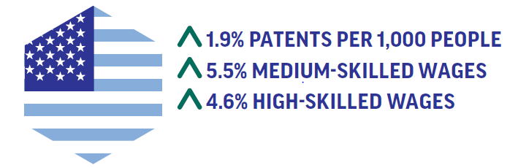
Compact, connected, clean cities are more productive and more innovative, driving medium- and long-term growth
Higher proximity and density enables specialisation, knowledge spillovers and economies of scale.
Countries with zero-carbon cities will win the global race for mobile talent and investment
Source: London School of Economics for the Coalition for Urban Transitions, 2019
Notes:
The productivity of workers and businesses is higher in larger, more densely populated cities, particularly those with good public transport networks.
Firms are more productive as can find specialised workers, inputs, and premises more easily.
Workers are also more productive as they can find jobs that are a better fit with their skills and access knowledge, education and training that enhances their skillset.
Larger urban markets also enables specialisation, which enhances the productivity of both workers and firms.
Density and proximity can also stimulate higher rates of innovation. The capacity of countries to both create and absorb innovations will be increasingly important for economic competitiveness in the future. New analysis by the LSE for this report finds:
In Europe, a 10% higher urban population density is associated with an increase of 1.1% in the number of patents per 1000 people.
In the US, a 10% higher urban population density correlates with an increase of 1.9% in the number of patents per 1000 people
Compact, connected and clean cities are also more attractive places to live and work. 1.2 billion workdays are lost every year due to air pollution, and related health care costs reach US$21 billion per year. Congestion, traffic injuries and costly sprawl also affect living standards. Zero-carbon, resilient cities offer a national competitive advantage in the global race for talent and investment.

Slide 9
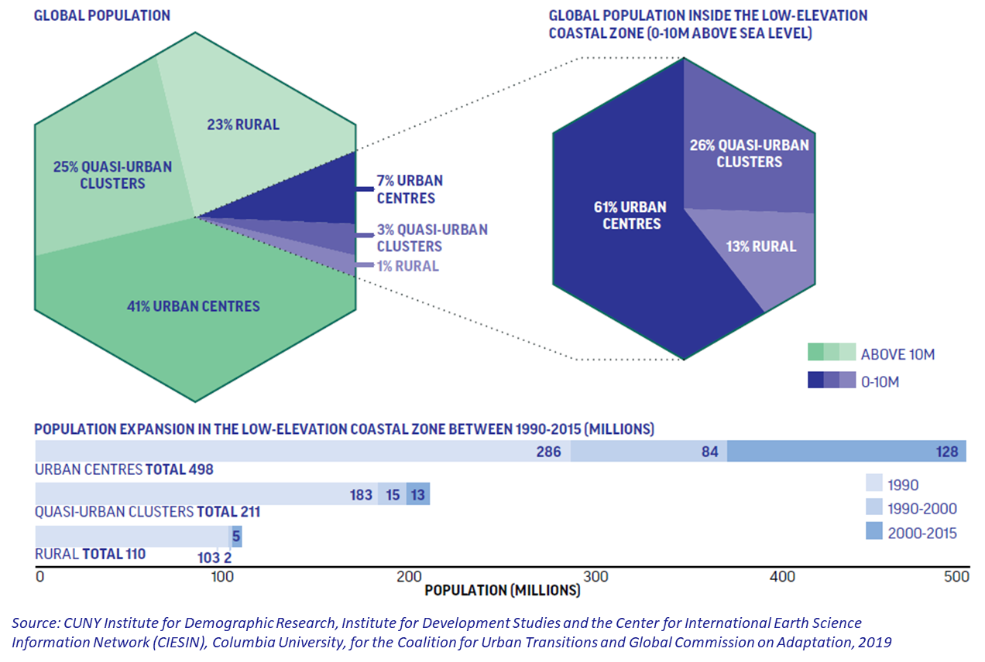
The costs of inaction are staggering: sea level rise is an urban threat
Over 10% of the world’s population - 820 million people - live less than 10 metres above sea level
86% of these people – over 700 million - live in urban centres or quasi-urban clusters
Populations in cities less than 10 metres above sea level are growing most rapidly
Notes:
New analysis for this report by CUNY Institute for Demographic Research, the Institute of Development Studies and the Center for International Earth Science Information Network (CIESIN) at Columbia University found that 12% of the world’s population – over 700 million people – lived within 10 metres above sea level in 2015, and nearly 90% of those people lived in urban centres or quasi-urban clusters (which have lower densities than urban centres, and could include peri-urban or suburban areas). Three quarters of this vulnerable urban population live in Asia.
Over 11% of the land in this low-lying coastal zone is already urban or quasi-urban, compared with less than 2% elsewhere (see Figure 6), which contributes to the fact that coastal population densities are six times higher than the rest of the world (318 versus 54 people per square kilometre). This means that storm surges and sea-level rise are now overwhelmingly urban threats.
Moreover, population growth rates since 1990 have been higher in these low-lying coastal zones, and the growth rates in urban centres are about 20% higher in these areas than elsewhere. Growth rates in urban centres are actually highest in the lowest-lying areas – at less than 5 metres above sea level. Most of these settlements have developed with little regard for coastal environmental sensitivities, and almost no regard for growing climate risks.

Slide 10
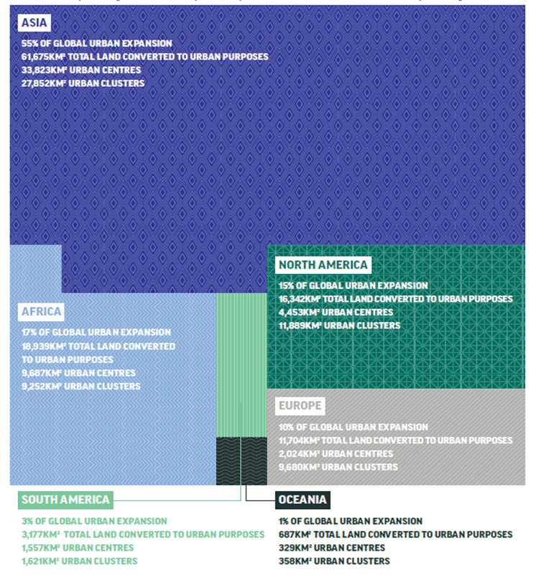
Climate mitigation and adaptation must go hand in hand: Compact urban growth enhances resilience and food security
112,524km² of land was converted to urban areas between 2000 and 2014 - twice the size of Sri Lanka
Over half was cultivated land
Over half was in Asia
Source: Marron Institute of Urban Management, New York University, for the Coalition for Urban Transitions and the Food and Land Use Coalition, 2019
Notes:
A new analysis by New York University for this report found that urban settlements grew by about 112,524 square kilometres between 2000 and 2014, twice the area of Sri Lanka.
Two thirds of this urban expansion occurred in Asia, and one fifth in Africa.
China alone accounted for 38.9% of the new urban extent, while a further 10.7% was in India. Thereafter, Nigeria, Mexico and Vietnam saw the most urban expansion, accounting for 4.9%, 2.0% and 1.2% of new urban land, respectively.

Slide 11
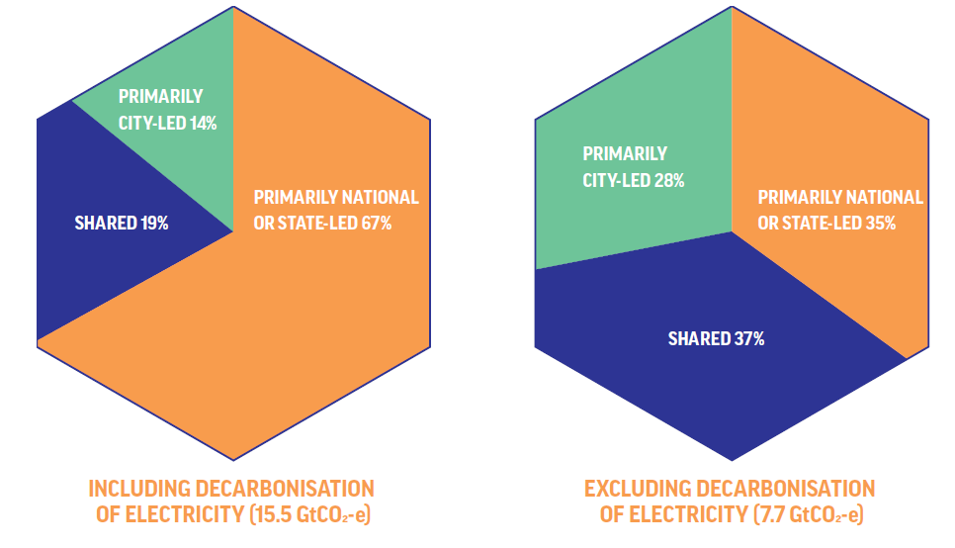
National governments have unique and crucial roles to play
Local governments cannot drive the zero-carbon urban transition alone
Source: Stockholm Environmental Institute for the Coalition for Urban Transitions, 2019
Notes:
Local governments cannot drive the zero-carbon transition on their own: national governments must play a critical role
New analysis for this report finds that, worldwide, national and state governments have primary authority over 35% of urban mitigation potential (excluding decarbonisation of electricity), including from improved cement production processes and more stringent efficiency standards for appliances, lighting and vehicles. Local governments have primary authority or influence over 28%, including compact urban form, travel demand management and waste disposal. 37% of the identified mitigation potential depends on collaborative climate action among national, regional and local governments, including building codes, decentralised renewables and mass transit infrastructure.
Bold national leadership is therefore needed to deliver these emission reductions and provide an enabling environment for local action
In the new analysis of powers, why have you separated the powers of different tiers of government into national and state led, local and city led, and multi-actor?
There is much global attention that has been given to the efforts of city governments, who are typically well-aware of their role in decarbonising cities. This report aims to remind us that these local-level governments cannot do it alone, hence grouping national and state together.
Additionally, in federal countries, states have many of the urban-relevant powers that national governments might hold in unitary countries (e.g. California on building codes). Hence our grouping.
Doesn’t this negate the narrative that cities are the bright spot in the climate action world?
On the contrary. Cities are still the bright spot for climate action. Low-carbon policies and investments in cities are often cost-effective, and generate wider benefits from new jobs to cleaner air. And city governments around the world should be commended for their ambitious climate commitments and innovative climate actions. Their ambition and energy has been a bright spot in international climate negotiations for over a decade.
But the Urban Opportunity report reminds us that city governments cannot create cities with net-zero emissions alone. In fact, it shows that they have primary authority over less than ⅓ of potential emission reductions in urban areas. This report therefore makes the case that much more collaborative action is needed, across different tiers of governments, if countries are to realise the many benefits of climate action in cities. National and state governments have primary responsibility for around ⅓ of urban mitigation potential, and the remaining 1/3 depends on different levels of government working together to cut emissions.
In short, cities are still the bright spot of the climate world. But this report demonstrates that far-sighted and supportive national leadership is needed to realise this urban opportunity.

Slide 12
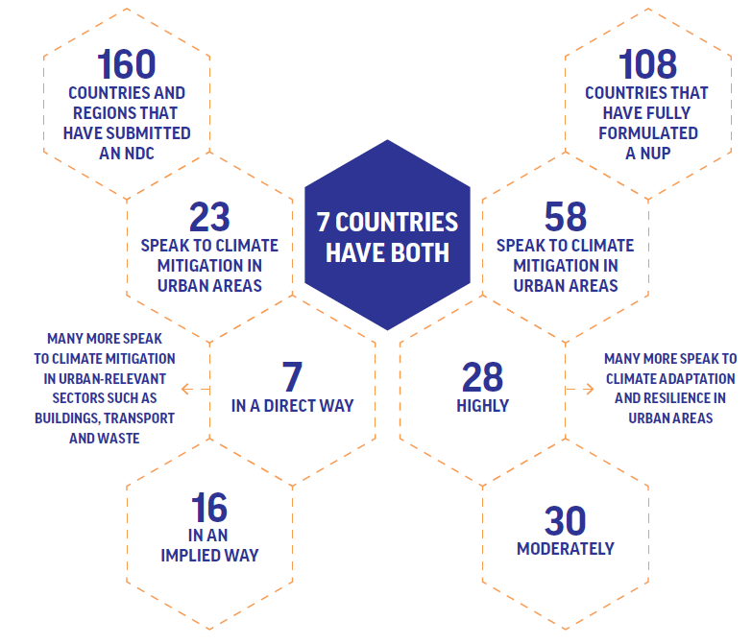
Yet, fewer than 2 in 5 countries have an explicit national strategy for cities
Only 39% of National Urban Policies and 14% of Nationally Determined Contributions speak specifically to climate mitigation in urban areas
Only seven countries have both an NDC and a NUP that speak to climate mitigation in urban areas
Source: Coalition for Urban Transitions, Organisation for Economic
Co-operation and Development, UN-Habitat and the University of Southern Denmark, 2019
Notes:
New analysis for this report finds that only seven countries have both an NDC and a NUP that speak to climate mitigation in urban areas. 23 countries have an NDC that speaks to climate mitigation in urban areas, while 58 countries have a NUP that speaks to this topic. But new analysis for this report finds that only Colombia, Fiji, Indonesia, Mongolia, Rwanda, South Sudan and Tonga have both NUPs and NDCs that address this issue (see Figure 13), although many more countries have NDCs and NUPs that speak to urban adaptation and resilience. NUPs and NDCs are, of course, a deeply imperfect proxy for national policy alignment on cities and climate change, let alone policy implementation: several countries, such as Sweden, have longstanding commitments to urban climate action that are not captured in their NDCs. Many more countries have urban-relevant pledges in their NDCs, promising to reduce emissions from buildings, electricity generation, transport and waste. These sector-based commitments are welcome. However, sectoral approaches miss two important opportunities in cities. First, they fail to capture the mitigation potential associated with spatially concentrating people, infrastructure and economic activity. For example, higher densities enable people to walk or cycle rather than using motorised transport. Second, sectoral approaches may not sufficiently empower local governments to pursue ambitious climate action within their jurisdictions. It is therefore important that national governments explicitly recognise cities as systems in their climate policies and plans. This analysis effectively illustrates that most national governments could go much farther to mainstream urban and climate perspectives across decision-making. If NDCs are not already addressing urban opportunities, there is immense scope to raise ambition during the climate negotiations.

Slide 13
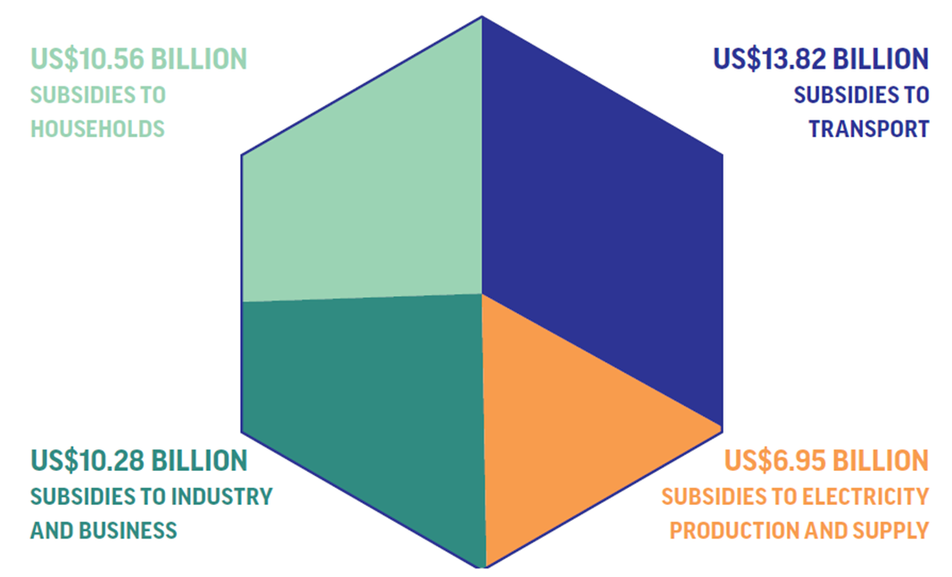
Governments in the OECD and BRIICS countries spend US$41.6 billion each year supporting fossil fuel consumption in urban areas
Source: Overseas Development Institute for the Coalition for Urban Transitions, 2019
Notes:
Fiscal systems not only generate revenue; they also establish incentives for certain economic decisions and behaviours. Today, tax policy, financial regulation and public spending often skew urban markets in favour of high-carbon growth. New analysis by the Overseas Development Institute for this report finds that governments in the OECD and BRIICS* countries spend US$41.6 billion each year subsidising fossil fuel consumption in urban areas. Subsidies were identified in most countries. Subsidies flowing to the transport sector amount to over US$13.82 billion per year; subsidies for households (for cooking, heating, lighting, etc.) amount to $US10.56 billion per year; subsidies for industry and commerce follow closely behind at US$10.28 billion per year; and subsidies for the generation of fossil fuel-based electricity consumed in urban areas reach almost US$6.95 billion per year (see Figure 14). A further, small amount (US$27.7 million) was identified for fossil fuel consumption in social and public services in urban areas not covered by the above categories. These are conservative estimates, because many fossil fuel subsidies are hidden, and even when they are identified, they often cannot be quantified. Accounting for the costs of urban air pollution, road accidents and climate change would increase the value of these subsidies by several orders of magnitude.311

Slide 14
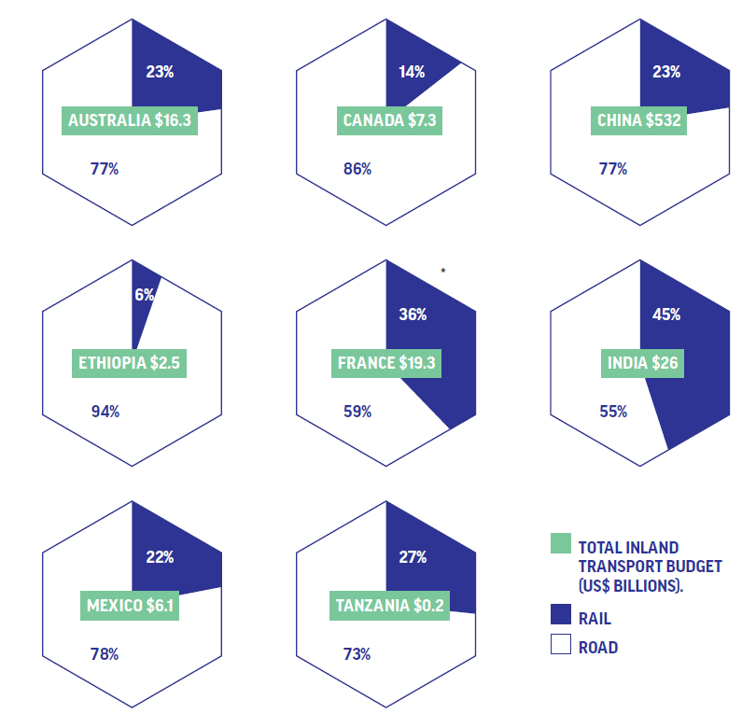
Most countries invest much more in road than rail
Source: Overseas Development Institute for the Coalition for Urban Transitions, 2019
Notes:
For fast-growing cities, shifting national transport budgets to support public and active transport projects could “lock in” more efficient use of urban land; for more established cities, it could accelerate densification. For all countries, improving rail networks among cities could do much to reduce the emissions from both personal travel and freight transport.
A new analysis by the Overseas Development Institute for this report focused on eight geographically and economically diverse countries and found that all spend far more on roads than on rail infrastructure. Australia, China, Mexico and Tanzania spent roughly US$3 on roads for every US$1 spent on rail. Spending on roads was even more dominant in Ethiopia and Canada, consuming 94% and 86% of their inland transport budgets, respectively. Ethiopia is already seeking to re-balance its spending, with a new Light Rail Transit project within Addis Ababa and a new railway connecting the capital to Djibouti. Meanwhile, India was found to have the most balanced portfolio, with 55% of all inland transport investment being directed to roads while 45% was spent on railways (see Figure 17).

Slide 15
Six priorities for national action to achieve inclusive, zero-carbon, resilient cities
The leading countries of tomorrow will be those that support an equitable and sustainable transition to a new urban economy
Notes:
The first and overarching recommendation is for national governments to prepare a national strategy to deliver shared prosperity while reaching net-zero emissions – and to put cities at the heart of it. Once this clear vision is in place, it can guide decision-making across different ministries, including how national governments (1) reform national policies, (2) fund and finance sustainable urban infrastructure, (3) empower local governments, and (4) engage with the multilateral system. All these national actions will be most successful if underpinned by a commitment to a just transition.
How do you account for differences in how local and national governments are structured or for countries / cities with different levels of development?
There are certain priorities for national action that are relevant in all parts of the world. For example, every country will need a clean electricity supply to achieve net-zero emissions in cities. Every country will need a just transition to sustain public support for urban climate action. However, the Urban Opportunity report fully recognises that different countries and cities will need different strategies to deliver these priorities.
The final chapter of the report lays out a toolbox of policy options that national governments can pick and choose from to achieve these priorities. Not all of these are relevant to every country. However, the toolbox as a whole has relevance to countries at all levels of development. Income levels should not constrain ambition: many low- and middle-income countries are undertaking ambitious and complex actions that high-income countries could emulate. China, for instance, is home to 99% of the world’s electric buses. Colombia has a price on carbon. The Urban Opportunity report clearly shows that national governments can select a bundle of low-carbon policies that suits their specific context.
Moreover, the Urban Opportunity report brings this diversity to life with a set of case studies from around the world. The stories from Chile (pg 90); China (pg 72); Medellín, Colombia (pg 48); Copenhagen, Denmark (pg 50); Germany (pg 100); Indore, India (pg 54); Indonesia (pg 96); Windhoek, Namibia (pg 44); Rwanda (pg 78); and Seoul, South Korea (pg 42) demonstrate how countries at very different levels of development and with very different governance arrangements all managed to transform their cities within a couple of decades. These case studies can serve as inspiration for other countries and cities seeking to emulate the lessons learnt.

Slide 16
There is a short window of opportunity open now: It is possible to rapidly transform cities within 2-3 decades
Success Stories - Countries
Improving housing quality in cities - Chile
Building robust tax and land systems – Rwanda
Redirecting fossil fuel subsidies – Indonesia
Improving and scaling electric vehicles – China
Expanding renewable energy technologies - Germany
Notes:
Improving housing quality in cities - Chile (pg 90): Chile’s housing policy was remarkable for successfully stimulating private-sector construction of housing for low- and middle-income urban families. This was accompanied by programmes to upgrade the quality of housing and services in campamentos (informal settlements), and provide better transport links to these communities. Together, these national policies enabled the massive expansion of good housing stock that was well-connected to jobs and services. Over two decades, Chile reduced its shortfall of decent housing by two thirds - despite rapid urban population growth.
Building robust tax and land systems - Rwanda (pg 78): After the genocide, the Rwandan government focused on establishing an efficient, fair tax system and transparent land registry that people trusted. It simplified payments and improved its records by introducing an electronic tax system, and spent the revenues on essential services like water, sanitation and health care. Tax revenue as a share of GDP rose from 3.6% in 1994 to 13.4% in 2013. Meanwhile, the national government built a digital land cadastre that contained boundary and ownership information for every one of Rwanda’s 10.4 million land parcels. The tax and land reforms collectively laid the foundations for both national and local governments in Rwanda to manage rapid urbanisation.
Redirecting fossil fuel subsidies - Indonesia (pg 96): In 2014, the Indonesian government spent 3.5 times more on fossil fuel subsidies than on social welfare, and twice as much as on capital investments. This effectively subsidised the sprawl, congestion and air pollution for which Jakarta is especially notorious. The national government therefore undertook bold reforms to cut fossil fuel subsidies. It avoided political backlash by explicitly reallocating these funds to support the poor, providing cash transfers, health insurance, financial assistance for students and low-interest loans for small businesses. In 2014, these efforts saved UD$15.6 billion in fossil fuel subsidies - equivalent to 10% of government expenditure.
Improving and scaling electric vehicles - China (pg 72): As of 2017, China was home to 40% of the world’s electric passenger cars and 99% of electric buses and electric two-wheelers worldwide. National R&D investments over the previous decade had dramatically improved electric vehicles; more recently, national policies had supported the deployment of electric vehicles and charging infrastructure in cities. This national-local partnership led to innovations in business models and procurement policies to complement technological progress. Today, China’s cities and firms are at the forefront of the electric vehicle revolution: Shenzhen is the first city in the world to electrify its entire public bus fleet.
Expanding renewable energy technologies - Germany (pg 100): Germany’s national plan to decarbonise the energy system, the Energiewende, has caused the share of renewable energy to increase from 6% of electricity production in 2000 to 38% in 2018. The Energiewende employs a wide range of policy instruments including quotas, taxes, feed-in tariffs, efficiency standards, permits, pilot projects and carbon pricing. Critically, the national government supports and empowers local partners to advance the Energiewende. Many municipal governments have established energy utilities that procure and/or invest in renewable energy: Stadtwerke München, for instance, plans to increase the city’s renewable energy share from 39% in 2019 to 100% by 2025.

Slide 17
There is a short window of opportunity open now: It is possible to rapidly transform cities within 2-3 decades
Success Stories - Cities
Providing affordable housing solutions – Windhoek, Namibia
Proactive planning for urban population growth – Seoul, South Korea
Protecting and rewarding cyclists - Copenhagen, Denmark
Transforming informal settlements - Medellín, Colombia
Sorting out solid waste management - Indore, India
Notes:
Providing affordable housing solutions - Namibia (pg 44): Windhoek City Council pioneered an innovative solution to rapid population growth and deep urban poverty. The city government demarcated small plots of land and installed basic services (such as water points and toilet blocks) to accommodate new families. This strategy allowed the city to shape land use and avoided the heavy health costs typically associated with informal settlement. The national Build Together Programme then provided low-cost loans to urban residents, enabling them to incrementally upgrade their houses and services over time. While the city remains deeply unequal, Windhoek stands out among sub-Saharan African cities for its low-cost shelter solutions and far-sighted land use planning.
Proactive planning for urban population growth - South Korea (pg 42): Proactive planning for population growth helped transform post-war Seoul into an ultra-modern megacity that powers the world’s 11th largest economy. Seoul’s population grew eight times over between 1950 and 1980. National land reform policies enabled the rapid expansion of housing supply and critical infrastructure investment to meet the needs of this booming population. Seoul’s world-class metro, which now transports over 10 million people every day, plays an especially pivotal role in keeping the city connected and affordable.
Protecting and rewarding cyclists - Copenhagen, Denmark (pg 50): Copenhagen today has 375 kilometres of dedicated lanes. Its cyclists request a collective 1.1 million fewer sick days than residents who don’t cycle and avoid 20,000 tonnes of carbon emissions every year. Cycling has flourished in Copenhagen not only because of the “pull” of good local infrastructure, but also national policies to “push” people away from car use. Governments in Denmark tax larger, more polluting cars more heavily, and charges high fees for vehicle registration, insurance, parking and disposal. Together, these strategies mean that nearly half of commutes to work or school in Copenhagen are by bicycle
Transforming informal settlements - Medellín, Colombia (pg 48): In 1992, Medellín was “the murder capital of the world”. Between 2008 and 2011, it attracted more than $600 million in foreign direct investment. This transformation was possible thanks to an ambitious programme to upgrade and integrate informal settlements into the city. The local government of Medellín granted legal tenure, improved houses and basic services, and connected the hillside settlements to the city centre through cable cars that carry up to 3,000 people an hour. The city’s massive metro system was largely financed by the national government. Today’s incomes in Medellín are the highest of any Colombian city.
Sorting out solid waste management - Indore, India (pg 54): Dramatic improvements in solid waste management moved Indore up the rankings from India’s 149th cleanest city to the cleanest city in the country in just four years. Thanks to the twice-daily, door-to-door waste collection services provided to households and businesses (including those in informal settlements), over 90% of Indore’s waste is now collected and sorted. Through a public-private partnership, the city built a biogas plant that generates 800 kg of biogas every day, which fuels about 15 city buses. The construction of over 12,500 household, community and public toilets helped alleviate open defecation. Improved sanitation and waste collection not only makes the city cleaner and prevents disease, but also offers its residents a sense of dignity and civic pride.

Slide 18
Notes:
Who funded this report?
The report has been funded by the UK’s Department for International Development and Department for Business, Energy, and Industrial Strategy, the German Federal Ministry for Energy, Nature Conservation, and Nuclear Safety, The Swedish Ministry of Environment, and the Global Covenant of Mayors for Energy and Climate.
The views expressed in the report do not necessarily reflect their official policies.

